Slide 1
2022 Draft
Operating and Capital Budgets
Prepared by: Andrea Tang
Financial Services
Date: December 6, 2021

Slide 2
Agenda
Budget Process
Survey Results
2022 Budget
  Tax-Supported Operating Budget
  Rate-Supported Operating Budget
  Capital Budget
Impact by Property Type
Value For Money
Conclusion
Next Steps

Slide 3
1. Budget Process
Feb - May
Planning, Development and Refinement
May
Target Setting
Oct - Nov
Budget Deliberation and Public Engagement
December
Budget Approval

Slide 4


2. Survey Results
Survey was open from October 21 to November 19
Theme “2022 Budget Future Ready: What is your vision for Newmarket’s Future”
Asked to rank 8 priorities in the order of importance
295 surveys were completed

Slide 5
2. Survey Results
Ranking | Priority
1 | Maintaining all service levels at the Town of Newmarket
2 | Continued funding for parks, trails and green spaces such as the Mulock Park
3 | Support for local businesses, job creation and economic development opportunities
4 | Investing in the Asset Replacement Fund (ARF) to maintain our roads, bridges, sidewalk, stormwater systems etc
5 | Ensuring Newmarket continues to be a leader in green initiatives and environmental stewardship
6 | Recreational programs and events for the community
7 | By-law enforcement (parking, property standards, bylaws etc.)
8 | Safe transportation experiences for the community (Traffic Mitigation Strategy / Active Transportation Plan)
19% ranked all priorities equally

Slide 6
3. 2022 Budget
Budget | $ in millions
Tax-Supported Operating Budget (Town, Fire, Library, Mulock Park, BIA) | 92.2
Rate-Supported Operating Budget (Water, Wastewater, Stormwater, Building Permits) | 49.4
Total Operating Budgets | 141.6
Capital Budget | 32.8
Total 2022 Budget | 174.4

Slide 7

3. 2022 Budget
A. Tax-Supported Operating Budget
 | Town | CYFS | Library | Total
$ in millions
Expenditures | 61.3 | 16.2 | 3.5 | 81.0
Reserve Transfers | 9.5 | 1.4 | 0.3 | 11.2
Total Expenditures & Transfers | 70.8 | 17.6 | 3.8 | 92.2
Non-Tax Revenues | -21.6 | -0.4 | -0.2 | -22.2
Tax Levy | 49.2 | 17.2 | 3.6 | 70.0

Slide 8

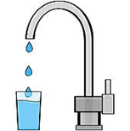


3. 2022 Budget
B. Rate-Supported Operating Budget
 | Water | Wastewater | Stormwater | Building
$ in millions
Expenditures | 16.9 | 19.9 | 1,5 | 2.8
Reserve Transfers | 3.4 | 3.8 | 1.1 | 0.0
Total Expenditures & Transfers | 20.3 | 23.7 | 2.6 | 2.8
Non-Rate Revenues | 0.0 | 0.0 | -0.1 | 0.0
Rates | 20.3 | 23.7 | 2.5 | 2.8

Slide 9
3. 2022 Budget
C. 2022 Capital Program Changes

Slide 10
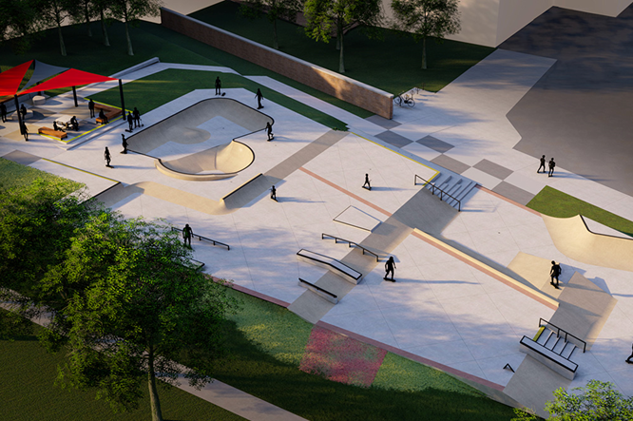
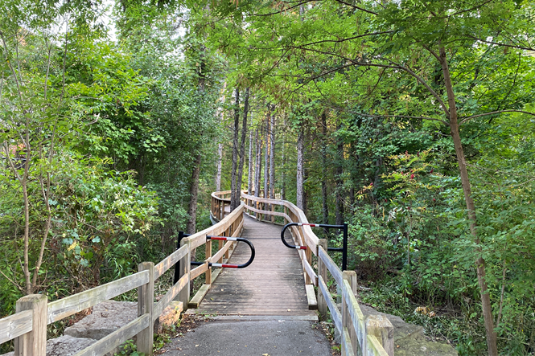
3. 2022 Budget
C. 2022 Capital Program

Slide 11
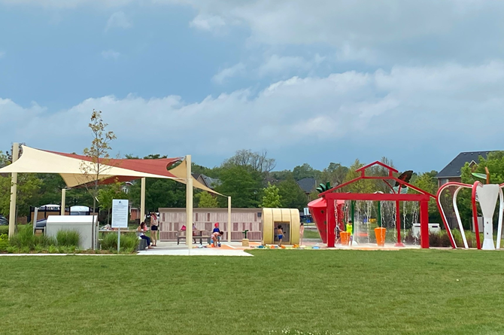
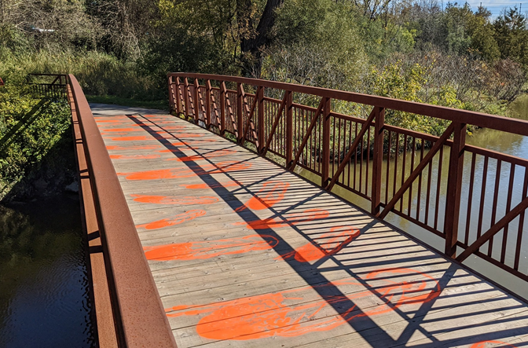
3. 2022 Budget
C. 2022 Capital Program by funding type

Slide 12
3. 2022 Budget
C. 2022 Capital Program by department

Slide 13
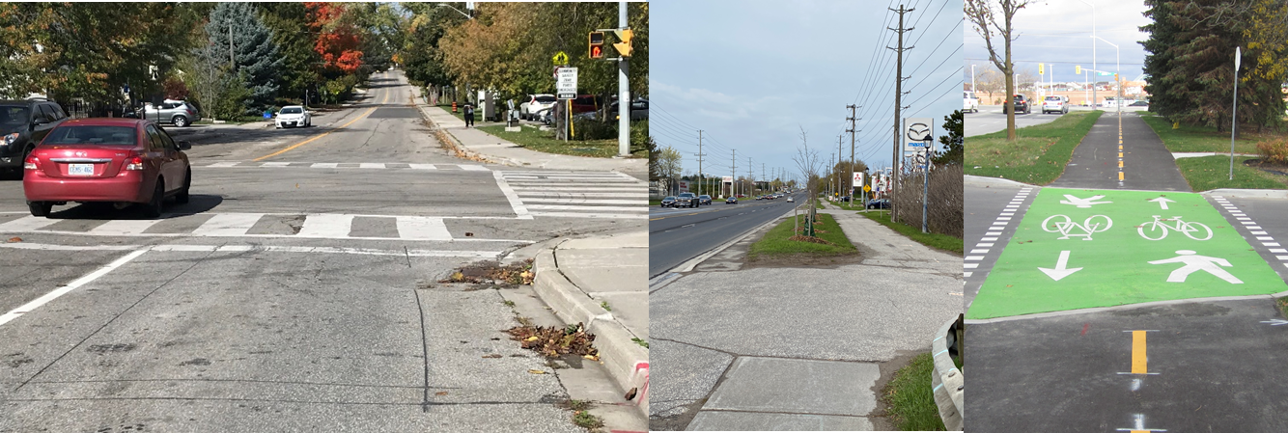
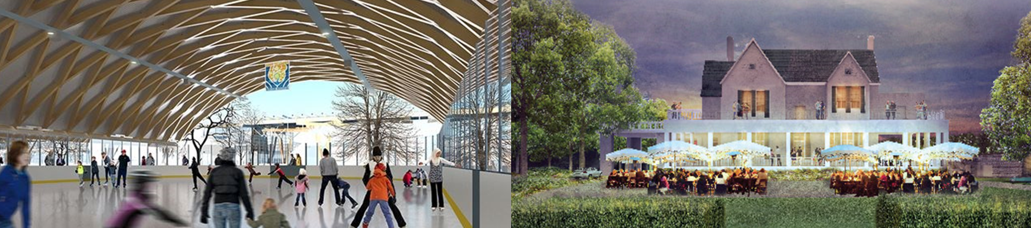
3. 2022 Budget
C. 2022 Capital Program Highlights

Slide 14

3. 2022 Budget
C. Future Capital Program

Slide 15
3. 2022 Budget
C. Capital Spending Authority

Slide 16
4. Impact by Property Type
 | 2022 Increase | Detached | Semi- Detached | Townhouse | Condo Apartment
Property Tax | 1.99% | $44.09 CVA* $702,400 | $30.09 CVA* $479,400 | $31.38 CVA* $499,900 | $21.97 CVA* $350,000
Water & Wastewater | 3.8% | $53.47 Usage 234m³ | $48.08 Usage 200m³ | $46.93 Usage 193m³ | $38.51 Usage 141m³
Stormwater | 10.00% | $5.91 | $2.92 | $2.23 | $0.40
Total |  | $103.47 | $81.09 | $80.54 | $60.88
* CVA – Current Value Assessment

Slide 17
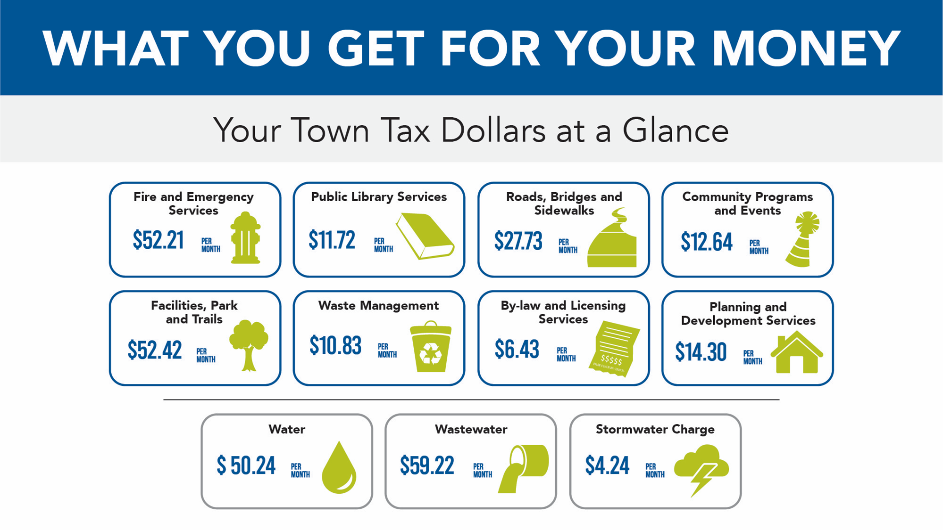
5. Value For Money

Slide 18

6. Conclusion
2022 Budget
addresses today’s needs on service delivery
invests in capital to address immediate and future growth
continues to increase contributions to the Asset Replacement Funds
achieves a balance between affordability and service delivery
builds upon the Town’s vision to continue making Newmarket “Well Beyond the Ordinary”

Slide 19
7. Next Steps
Activity | Date | Meeting
Approval | Dec. 13 | Council
Reserve & Reserve Fund Budget | Q2 2022 | CoW
Budget Consolidation for Financial Statements | Q2 2022 | CoW
Quarterly Updates |  | CoW
CoW – Committee of the Whole

